Slide 1
Chapter 4: Routing Concepts
Routing & Switching
Notes:
Cisco Networking Academy program
Routing Protocols
Chapter 4: Routing Concepts

Slide 2
Chapter 4
4.0 Routing Concepts
4.1 Initial Configuration of a Router
4.2 Routing Decisions
4.3 Router Operation
4.4 Summary

Slide 3
Chapter 4: Objectives
Configure a router to route between multiple directly connected networks
Describe the primary functions and features of a router.
Explain how routers use information in data packets to make forwarding decisions in a small- to medium-sized business network.
Explain the encapsulation and de-encapsulation process used by routers when switching packets between interfaces.
Compare ways in which a router builds a routing table when operating in a small- to medium-sized business network.
Explain routing table entries for directly connected networks.
Explain how a router builds a routing table of directly connected networks.
Notes:
4.

Slide 4
Chapter 4: Objectives (cont.)
Explain how a router builds a routing table using static routes.
Explain how a router builds a routing table using a dynamic routing protocol.
Notes:
4.

Slide 5
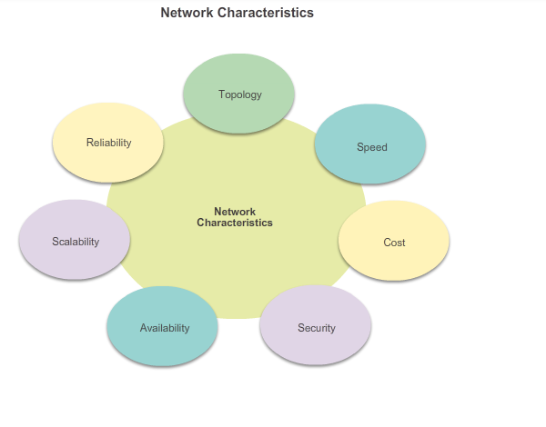
Functions of a Router Characteristics of a Network
Notes:
4.1.1.1 Characteristics of a Network

Slide 6
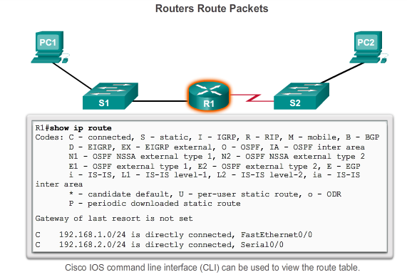
Functions of a Router Why Routing?
The router is responsible for the routing of traffic between networks.
Notes:
4.1.1.2 Why Routing?

Slide 7
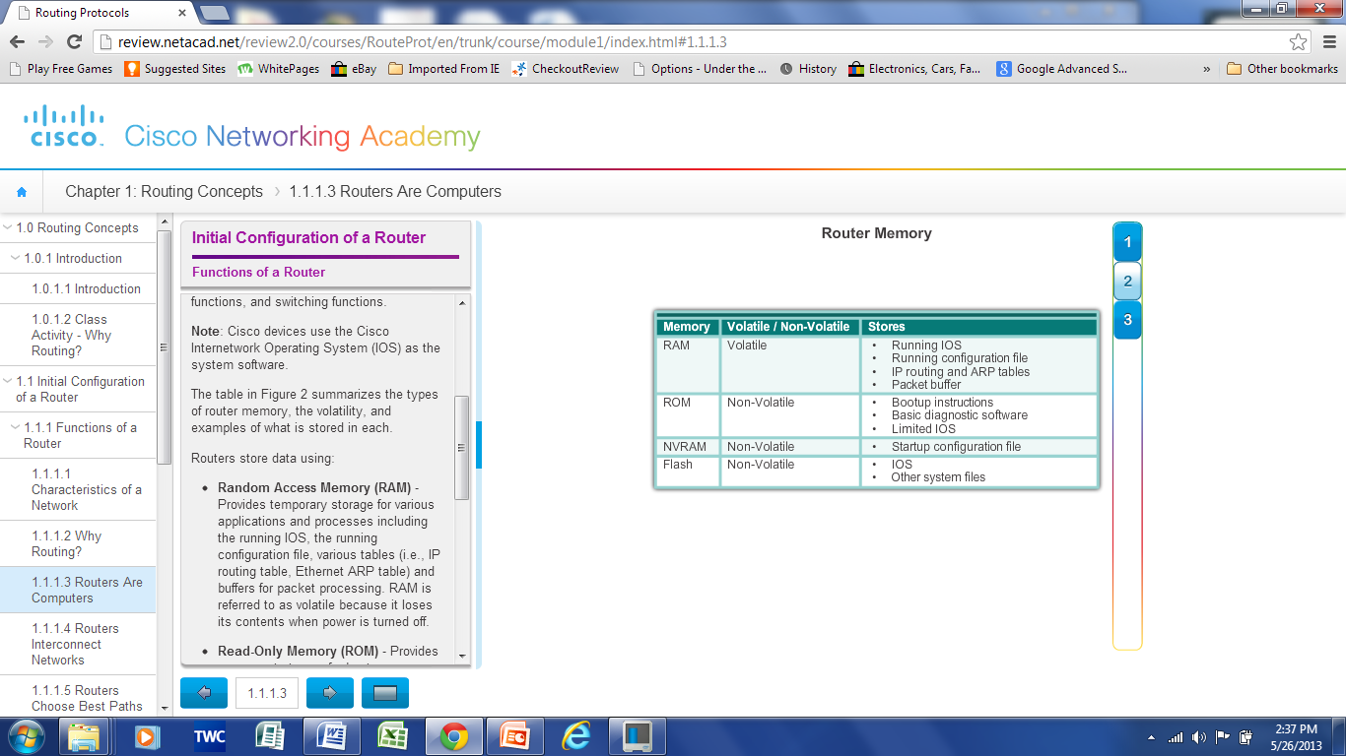
Functions of a Router Routers are Computers
Routers are specialized computers containing the following required components to operate:
Central processing unit (CPU)
Operating system (OS) - Routers use Cisco IOS
Memory and storage (RAM, ROM, NVRAM, Flash, hard drive)
Notes:
4.1.1.3 Routers are Computers

Slide 8
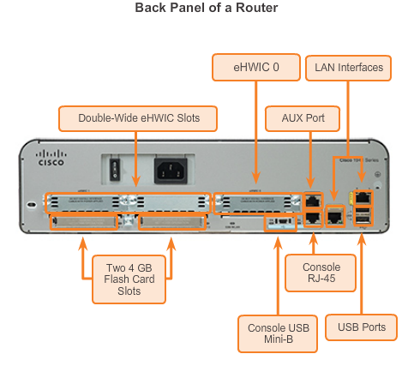
Functions of a Router Routers are Computers
Routers use specialized ports and network interface cards to interconnect to other networks.
Notes:
4.1.1.3 Routers are Computers

Slide 9
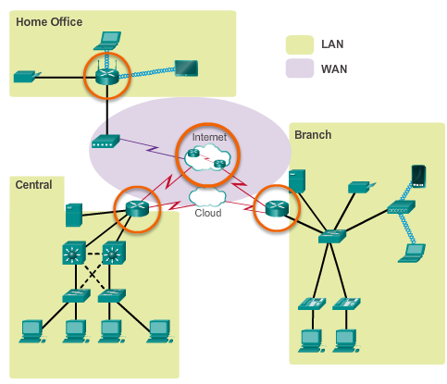
Functions of a Router Routers Interconnect Networks
Routers can connect multiple networks.
Routers have multiple interfaces, each on a different IP network.
Notes:
4.1.1.4 Routers Interconnect Networks

Slide 10
Functions of a Router Routers Choose Best Paths
Routers use static routes and dynamic routing protocols to learn about remote networks and build their routing tables.
Routers use routing tables to determine the best path to send packets.
Routers encapsulate the packet and forward it to the interface indicated in routing table.
Notes:
4.1.1.5 Routers Choose Best Paths

Slide 11
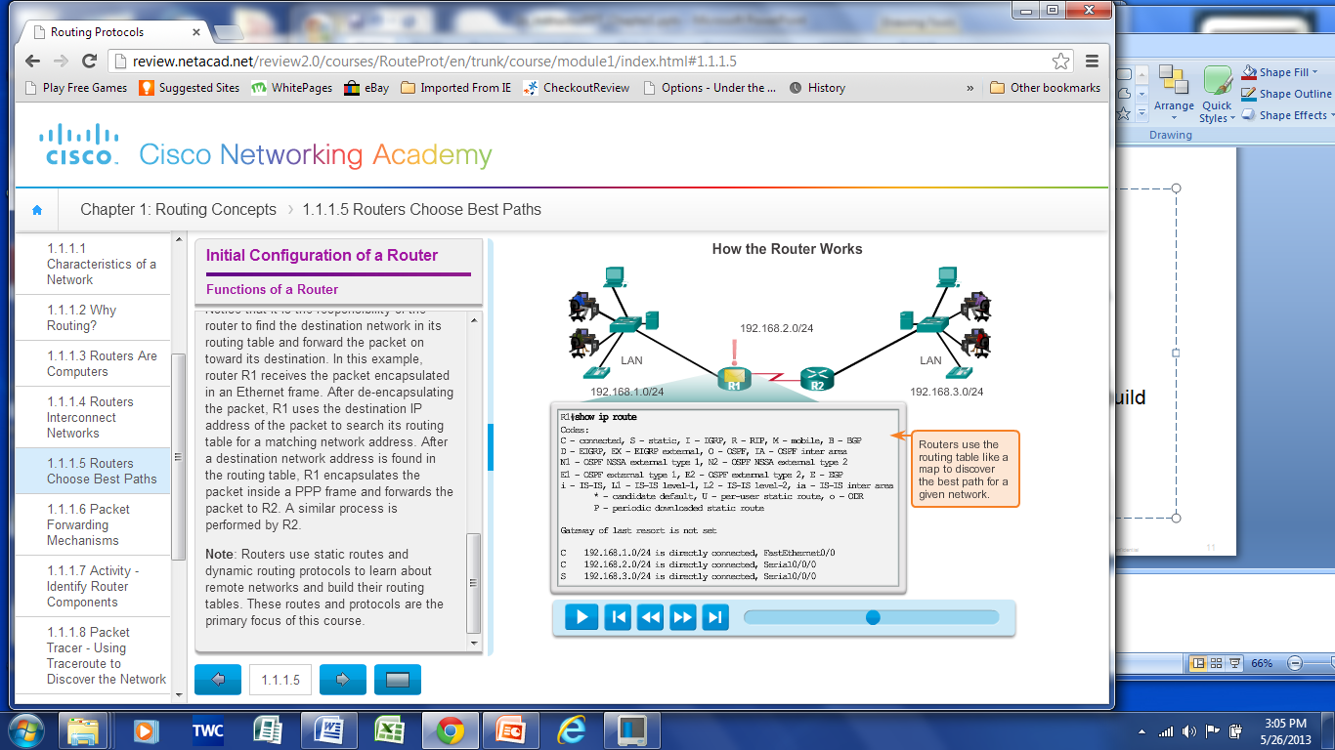
Functions of a Router Routers Choose Best Paths
Notes:
4.1.1.5 Routers Choose Best Paths

Slide 12
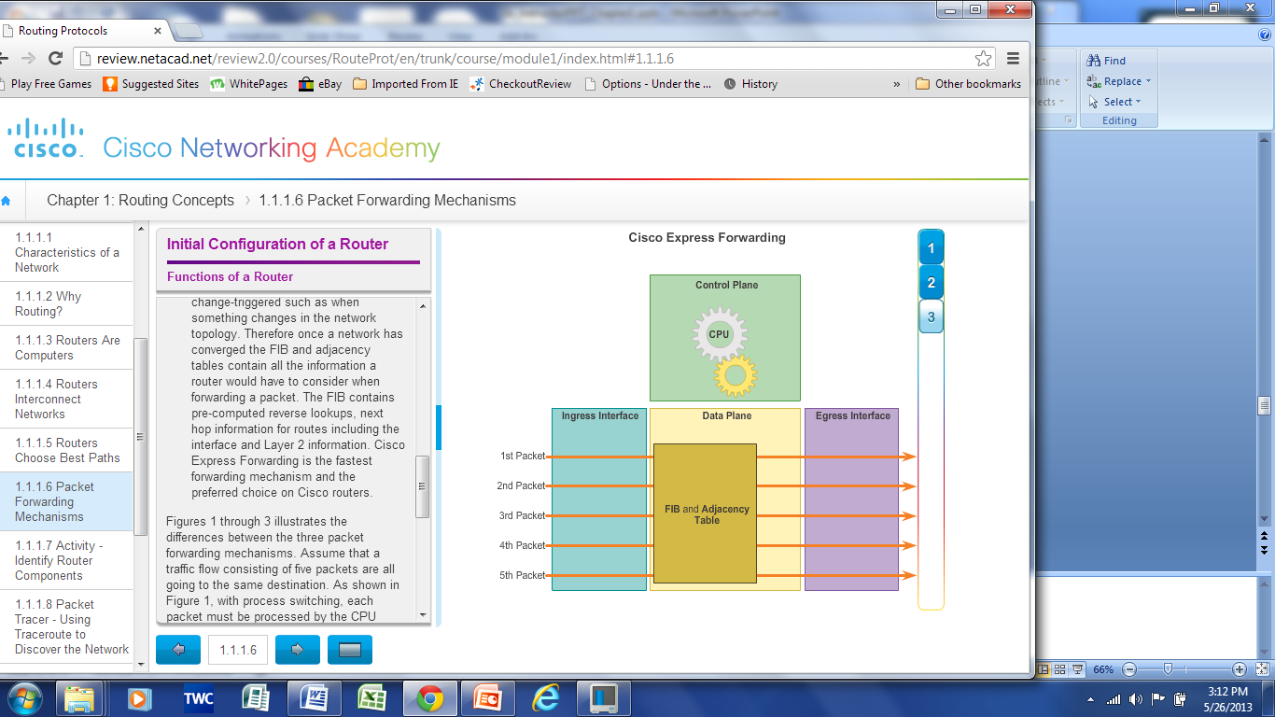
Functions of a Router Packet Forwarding Methods
Process switching – An older packet forwarding mechanism still available for Cisco routers.
Fast switching – A common packet forwarding mechanism which uses a fast-switching cache to store next hop information.
Cisco Express Forwarding (CEF) – The most recent, fastest, and preferred Cisco IOS packet-forwarding mechanism. Table entries are not packet-triggered like fast switching but change-triggered.
Notes:
4.1.1.6 Packet Forwarding Methods
4.1.1.7 Activity – Identify Router Components
4.1.1.8 Packet Tracer – Using Traceroute to Discover Networks
4.1.1.9 Lab – Mapping the Internet

Slide 13
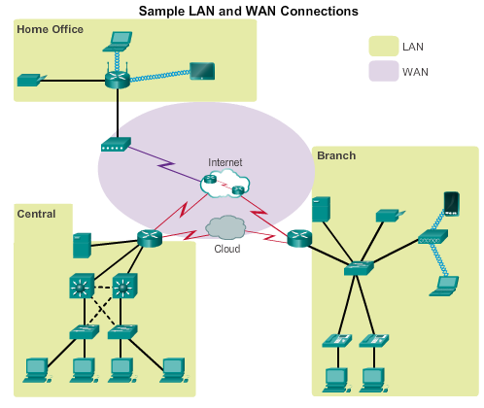
Connect Devices Connect to a Network
Notes:
4.1.2.1 Connect to a Network

Slide 14
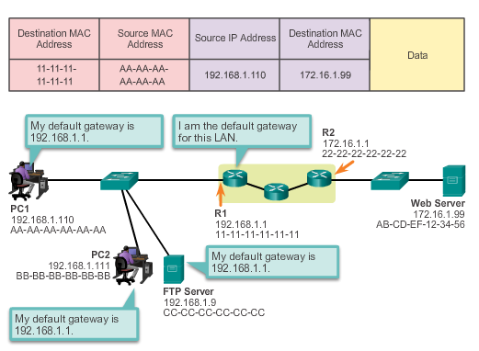
Connect Devices Default Gateways
To enable network access devices must be configured with the following IP address information
IP address - Identifies a unique host on a local network.
Subnet mask - Identifies the host’s network subnet.
Default gateway - Identifies the router a packet is sent to to when the destination is not on the same local network subnet.
Notes:
4.1.2.2 Default Gateways

Slide 15
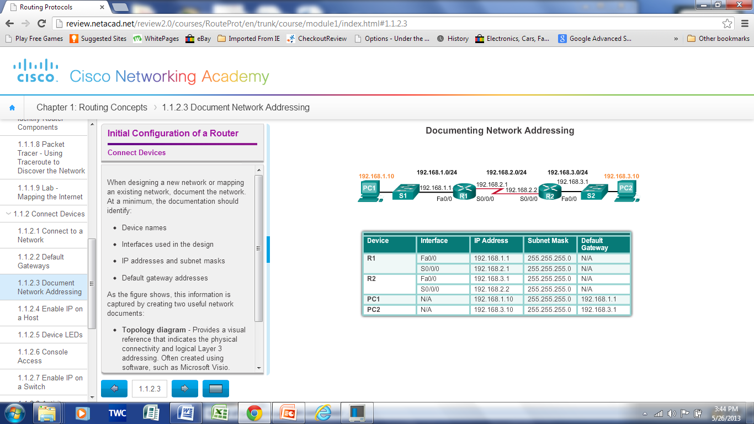
Connect Devices Document Network Addressing
Network Documentation should include at least the following in a topology diagram and addressing table:
Device names
Interfaces
IP addresses and
subnet mask
Default gateways
Notes:
4.1.2.3 Document Network Addressing

Slide 16
Connect Devices Enable IP on a Host
Statically Assigned IP address – The host is manually assigned an IP address, subnet mask and default gateway. A DNS server IP address can also be assigned.
Used to identify specific network resources such as network servers and printers.
Can be used in very small networks with few hosts.
Dynamically Assigned IP Address – IP Address information is dynamically assigned by a server using Dynamic Host Configuration Protocol (DHCP).
Most hosts acquire their IP address information through DHCP.
DHCP services can be provided by Cisco routers.
Notes:
4.1.2.4 Enable IP on a Host

Slide 17
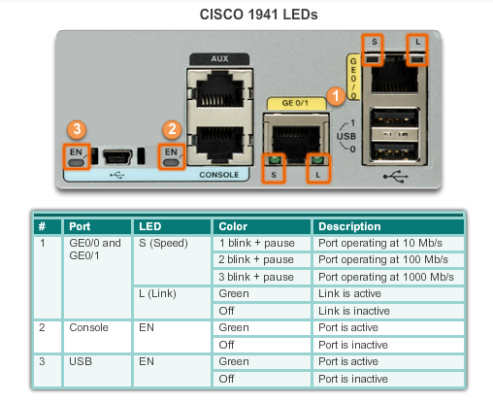
Connect Devices Device LEDs
Notes:
4.1.2.5 Device LEDs

Slide 18
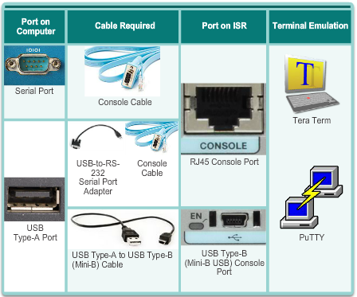
Connect Devices Console Access
Console access requires:
Console cable – RJ-45-to-DB-9 console cable
Terminal emulation software – Tera Term, PuTTY, HyperTerminal
Notes:
4.1.2.6 Console Access

Slide 19
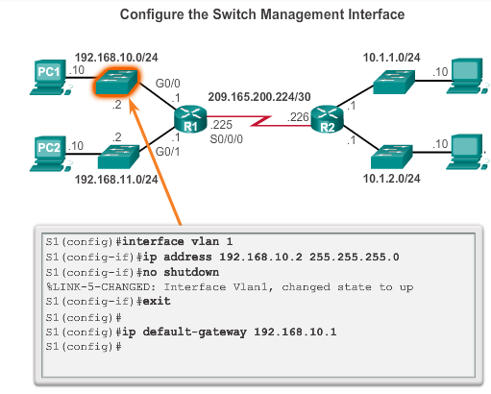
Connect Devices Enable IP on a Switch
Network infrastructure devices require IP addresses to enable remote management.
On a switch, the management IP address is assigned on a virtual interface.
Notes:
4.1.2.7 Enable IP on a Switch
4.1.2.8 Activity – Document an Addressing Scheme
4.1.2.9 Packet Tracer – Documenting the Network

Slide 20
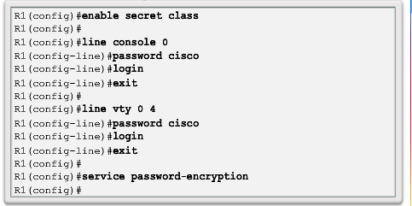
Basic Settings on a Router Configure Basic Router Settings
Basics tasks that should be first configured on a Cisco Router and Cisco Switch:
Name the device – Distinguishes it from other routers
Secure management access – Secures privileged EXEC, user EXEC, and Telnet access, and encrypts passwords to their highest level
Configure a banner – Provides legal notification of unauthorized access.
Save the Configuration
Notes:
4.1.3.1 Configure Basic Router Settings

Slide 21
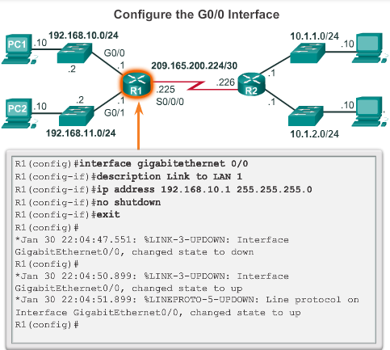
Basic Settings on a Router Configure an IPv4 Router Interface
To be available, a router interface must be:
Configured with an address and subnet mask .
Must be activated using no shutdown command. By default LAN and WAN interfaces are not activated.
Serial cable end labeled DCE must be configured with the clock rate command.
Optional description can be included.
Notes:
4.1.3.2 Configure an IPv4 Router Interface

Slide 22
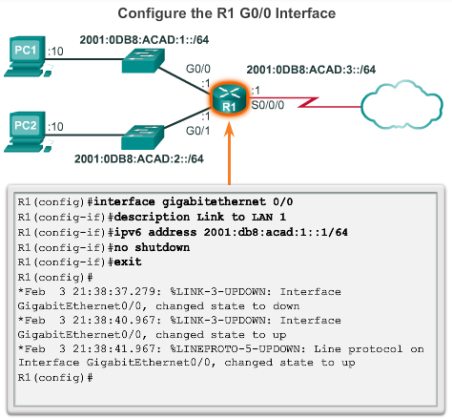
Basic Settings on a Router Configure an IPv6 Router Interface
To configure interface with IPv6 address and subnet mask:
Use the ipv6 address ipv6-address/ipv6-length [link-local | eui-64]interface configuration command.
Activate using the no shutdown command.
IPv6 interfaces can support more than one address:
Configure a specified global unicast - ipv6-address /ipv6-length
Configure a global IPv6 address with an interface identifier (ID) in the low-order 64 bits - ipv6-address /ipv6-length eui-64
Configure a link-local address - ipv6-address /ipv6-length link-local
Notes:
4.1.3.3 Configure an IPv6 Router Interface

Slide 23
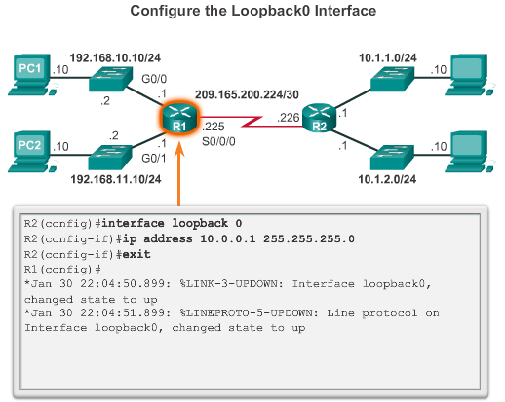
Basic Settings on a Router Configure a Loopback Interface
A loopback interface is a logical interface that is internal to the router:
It is not assigned to a physical port, it is considered a software interface that is automatically in an UP state.
A loopback interface is useful for testing.
It is important in the OSPF routing process.
Notes:
4.1.3.5 Packet Tracer – Configuring IPv4 and IPv6 Interfaces

Slide 24
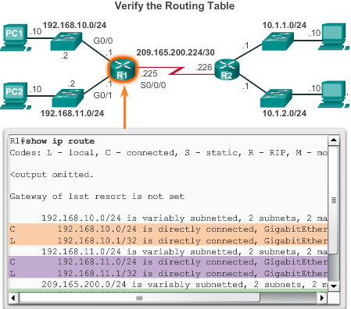
Verify Connectivity of Directly Connected Networks Verify Interface Settings
Show commands are used to verify operation and configuration of interface:
show ip interfaces brief
show ip route
show running-config
Show commands are used to gather more detailed interface information:
show interfaces
show ip interfaces
Notes:
4.1.4.1 Verify Interface Settings

Slide 25
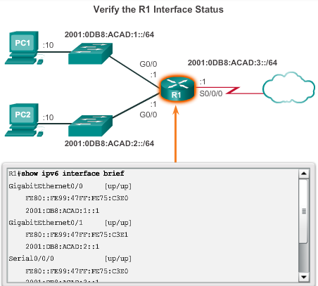
Verify Connectivity of Directly Connected Networks Verify Interface Settings
Some of the common commands to verify the IPv6 interface configuration are:
show ipv6 interface brief - displays a summary for each of the interfaces.
show ipv6 interface gigabitethernet 0/0 - displays the interface status and all the IPv6 addresses for this interface.
show ipv6 route - verifies that IPv6 networks and specific IPv6 interface addresses have been installed in the IPv6 routing table.
Notes:
4.1.4.2.Verify IPv6 Interface Settings

Slide 26
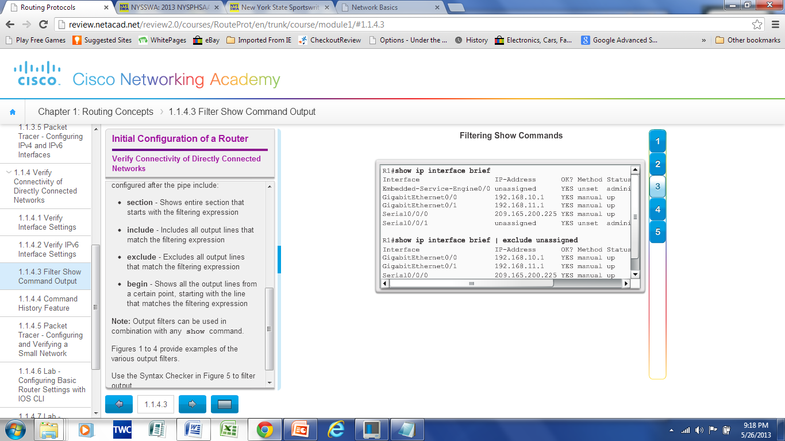
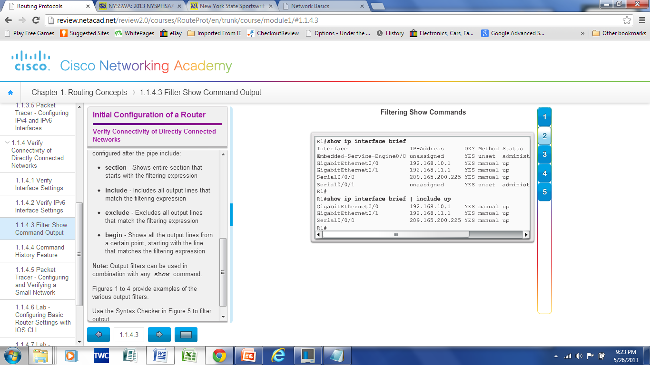
Verify Connectivity of Directly Connected Networks Filter Show Command Output
Show command output can be managed using the following command and filters:
Use the terminal length number command to specify the number of lines to be displayed. A value of 0 (zero) prevents the router from pausing between screens of output.
To filter specific output of commands use the (|)pipe character after show command. Parameters that can be used after pipe include:
section, include, exclude, begin
Notes:
4.1.4.3 Filter Show Command Output

Slide 27
Verify Connectivity of Directly Connected Networks Command History Feature
The command history feature temporarily stores a list of executed commands for access:
To recall commands press Ctrl+P or the UP Arrow.
To return to more recent commands press Ctrl+N or the Down Arrow.
By default, command history is enabled and the system captures the last 10 commands in the buffer. Use the show history privileged EXEC command to display the buffer contents.
Use the terminal history size user EXEC command to increase or decrease size of the buffer.
Notes:
4.1.4.4 Command History Feature
4.1.4.5 Packet Tracer – Configuring and Verifying a Small Network
4.1.4.6 Lab – Configuring Basic Router Settings with IOS CLI
4.1.4.7 Lab – Configuring Basic Router Settings with CCP

Slide 28
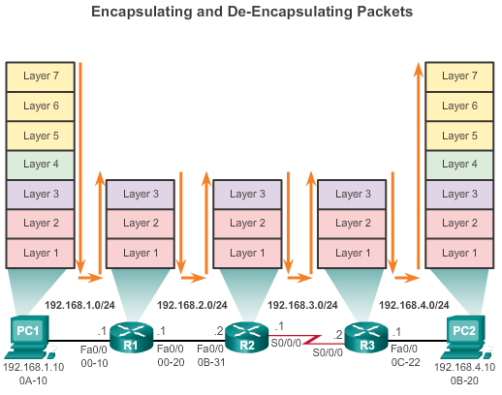
Switching Packets between Networks Router Switching Functions
Notes:
4.2.1.1 Router Switching Functions

Slide 29
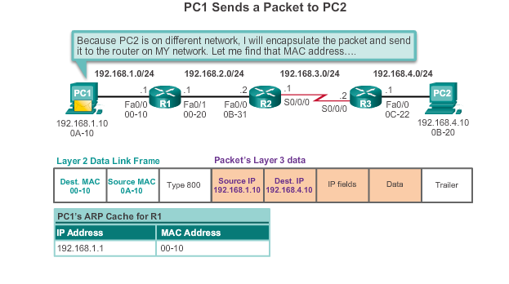
Switching Packets between Networks Send a Packet
Notes:
4.2.1.2 Send a Packet

Slide 30
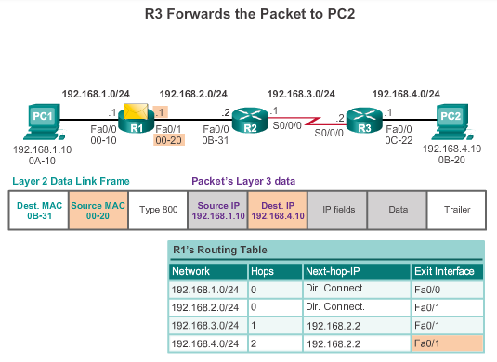
Switching Packets between Networks Forward to the Next Hop
Notes:
4.2.1.3 Forward to the Next Hop

Slide 31
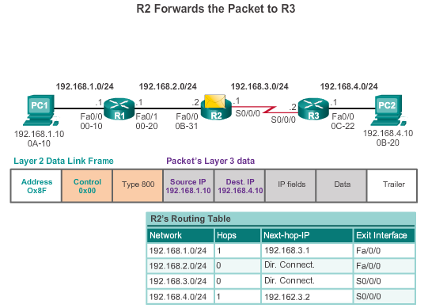
Switching Packets between Networks Packet Routing
Notes:
4.2.1.4 Packet Routing

Slide 32
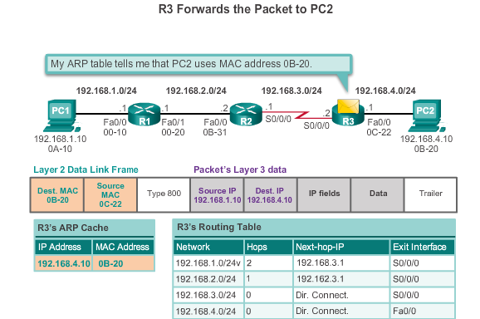
Switching Packets between Networks Reach the Destination
Notes:
4.2.1.5 Reach the Destination
4.2.1.6 Activity – Match Layer 2 and Layer 3 Addressing

Slide 33
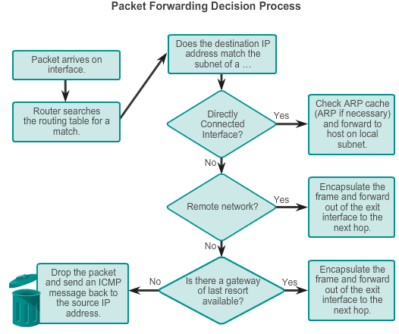
Path Determination Routing Decisions
Notes:
4.2.2.1 Routing Decisions

Slide 34
Path Determination Best Path
Best path is selected by a routing protocol based on the value or metric it uses to determine the distance to reach a network:
A metric is the value used to measure the distance to a given network.
Best path to a network is the path with the lowest metric.
Dynamic routing protocols use their own rules and metrics to build and update routing tables:
Routing Information Protocol (RIP) - Hop count
Open Shortest Path First (OSPF) - Cost based on cumulative bandwidth from source to destination
Enhanced Interior Gateway Routing Protocol (EIGRP) - Bandwidth, delay, load, reliability
Notes:
4.2.2.2 Best Path

Slide 35
Path Determination Load Balancing
When a router has two or more paths to a destination with equal cost metrics, then the router forwards the packets using both paths equally:
Equal cost load balancing can improve network performance.
Equal cost load balancing can be configured to use both dynamic routing protocols and static routes.
RIP, OSPF and EIGRP support equal cost load balancing.
Notes:
4.2.2.3 Load Balancing

Slide 36
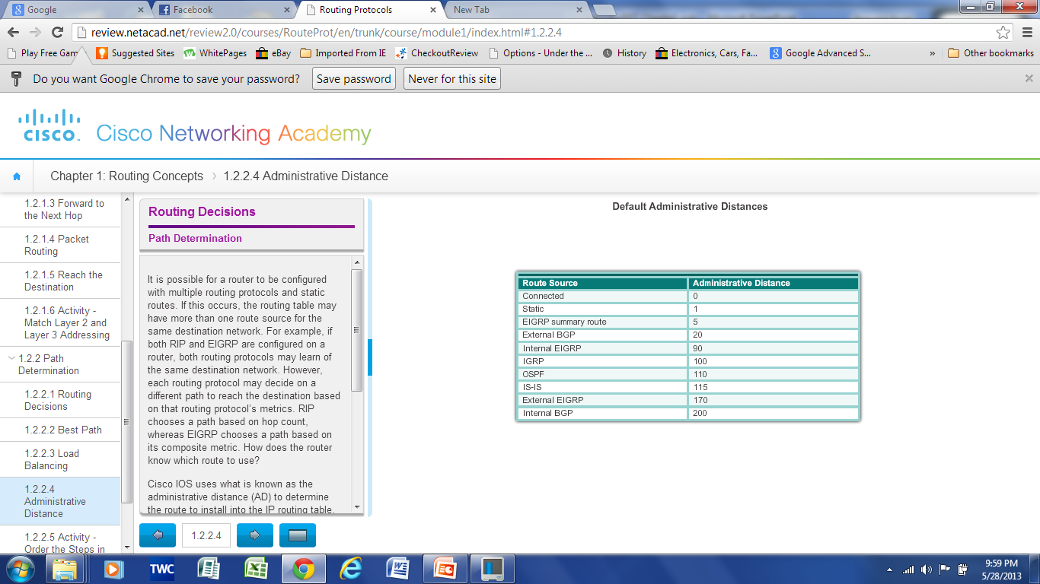
Path Determination of the route Administrative Distance
If multiple paths to a destination are configured on a router, the path installed in the routing table is the one with the lowest Administrative Distance (AD):
A static route with an AD of 1 is more reliable than an EIGRP-discovered route with an AD of 90.
A directly connected route with an AD of 0 is more reliable than a static route with an AD of 1.
Notes:
4.2.2.4 Administrative Distance
4.2.2.5 Activity – Order the Steps in the Packet Forwarding Process

Slide 37
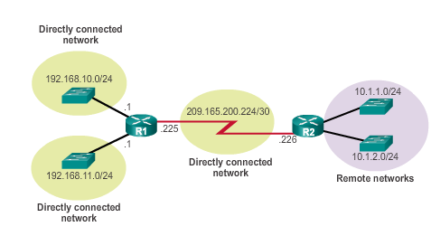
The Routing Table The Routing Table
A routing table is a file stored in RAM that contains information about:
Directly connected routes
Remote routes
Network or next hop associations
Notes:
4.3.1.1 The Routing Table

Slide 38
The Routing Table Routing Table Sources
The show ip route command is used to display the contents of the routing table:
Local route interfaces - Added to the routing table when an interface is configured. (displayed in IOS 15 or newer)
Directly connected interfaces - Added to the routing table when an interface is configured and active.
Static routes - Added when a route is manually configured and the exit interface is active.
Dynamic routing protocol - Added when EIGRP or OSPF are implemented and networks are identified.
Notes:
4.3.1.2 Routing Table Sources

Slide 39
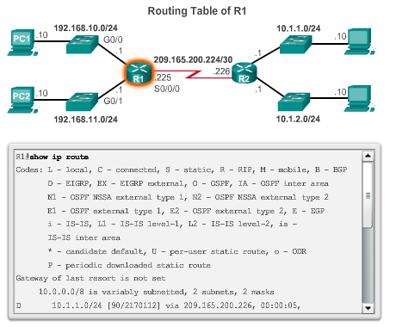
The Routing Table Routing Table Sources
Notes:
4.3.1.2 Routing Table Sources

Slide 40
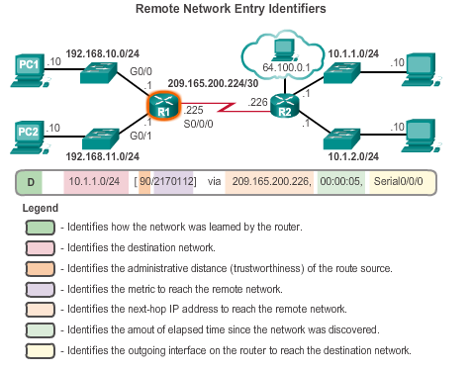
The Routing Table Remote Network Routing Entries
Interpreting the entries in the routing table.
Notes:
4.3.1.3 Remote Network Routing Entries
4.3.1.4 Activity- Interpret the Content of a Routing Table Entry

Slide 41
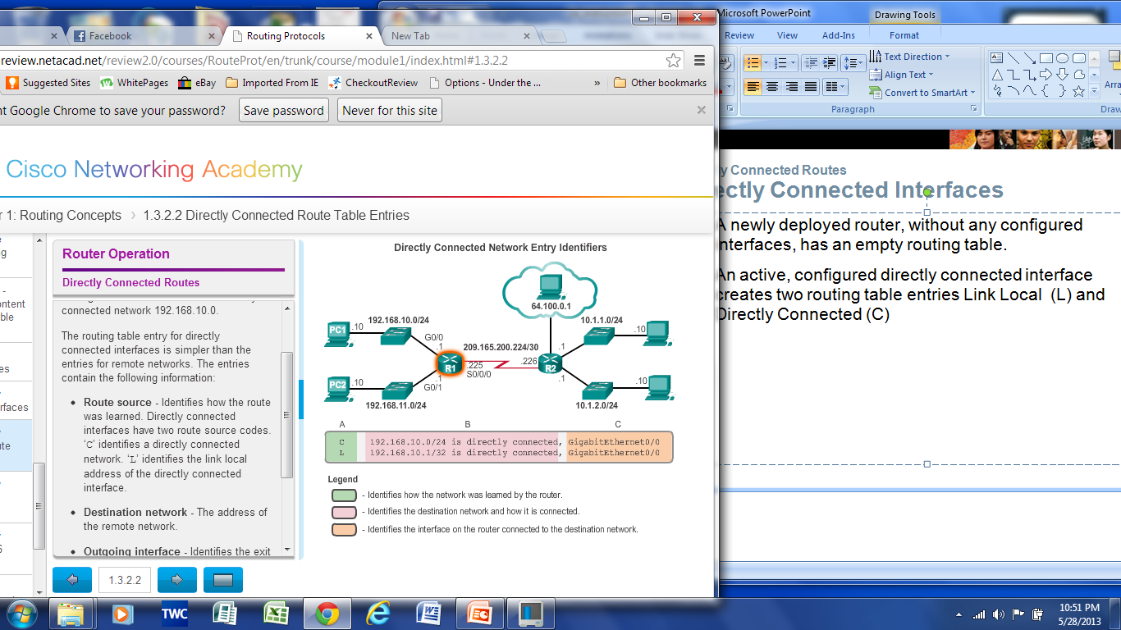
Directly Connected Routes Directly Connected Interfaces
A newly deployed router, without any configured interfaces, has an empty routing table. An active, configured, directly connected interface creates two routing table entries:
Link Local (L)
Directly Connected (C)
Notes:
4.3.2.1 Directly Connected Interfaces
4.3.2.2 Directly Connected Route Table Entries

Slide 42
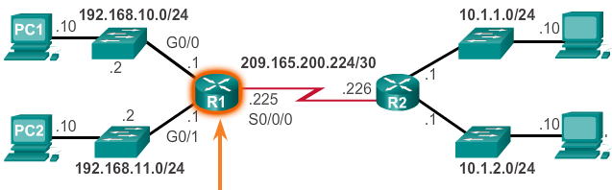
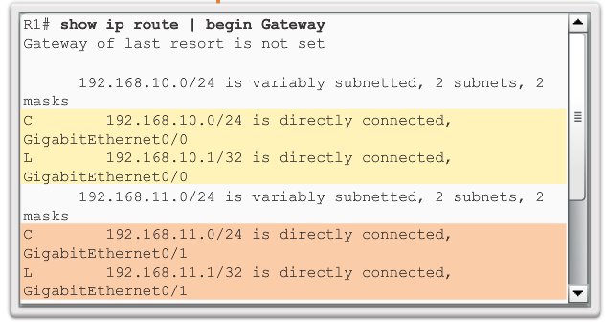
Directly Connected Routes Directly Connected Example
A routing table with the directly connected interfaces of R1 configured and activated.
Notes:
4.3.2.3 Directly Connected Route Table Entries

Slide 43
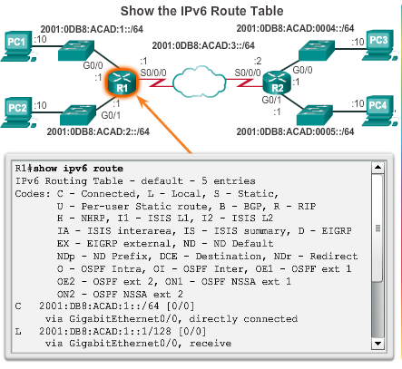
Directly Connected Routes Directly Connected IPv6 Example
The show ipv6 route command shows the ipv6 networks and routes installed in the routing table.
Notes:
4.3.2.4 Directly Connected IPv6 Example
4.3.2.5 Packet Tracer – Investigating Directly Connected Routes

Slide 44
Statically Learned Routes Static Routes
Static routes and default static routes can be implemented after directly connected interfaces are added to the routing table:
Static routes are manually configured
They define an explicit path between two networking devices.
Static routes must be manually updated if the topology changes.
Their benefits include improved security and control of resources.
Configure a static route to a specific network using the ip route network mask {next-hop-ip | exit-intf} command.
A default static route is used when the routing table does not contain a path for a destination network.
Configure a default static route using the ip route 0.0.0.0 0.0.0.0 {exit-intf | next-hop-ip} command.
Notes:
4.3.3.1 Static Routes

Slide 45
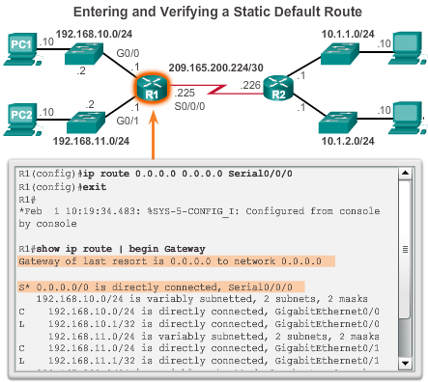
Statically Learned Routes Default Static Routes Example
Notes:
4.3.3.2 Default Static Routes Example

Slide 46
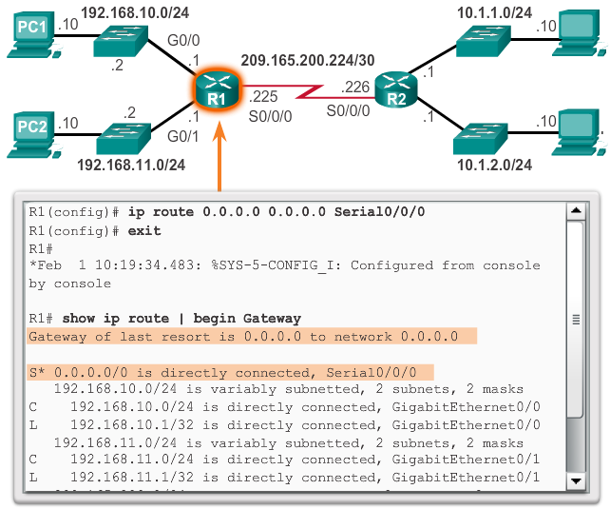
Statically Learned Routes Static Routes Example
Notes:
4.3.3.2 Static Routes Example (cont.)

Slide 47
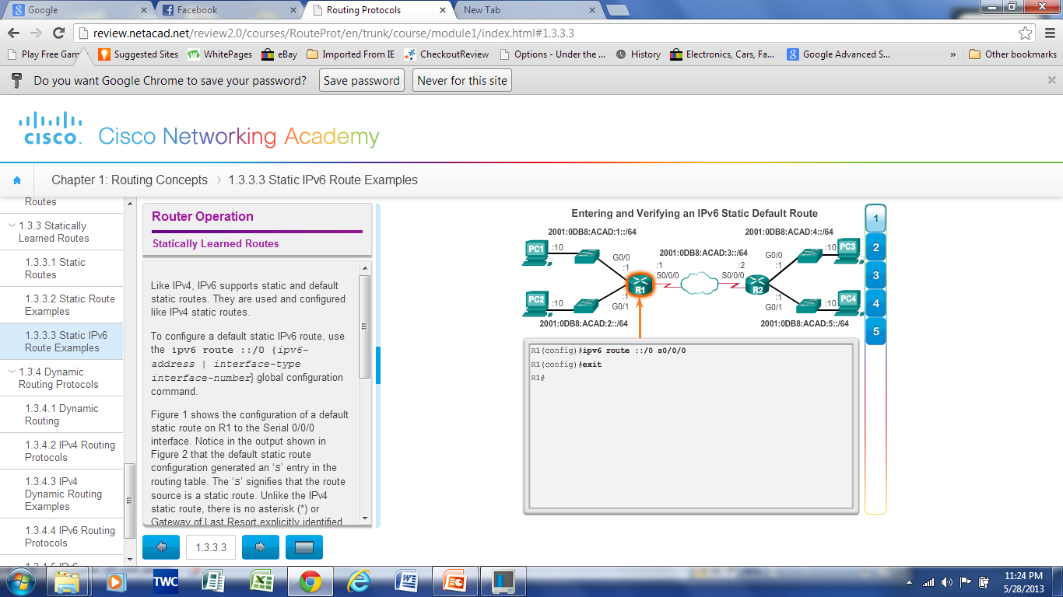
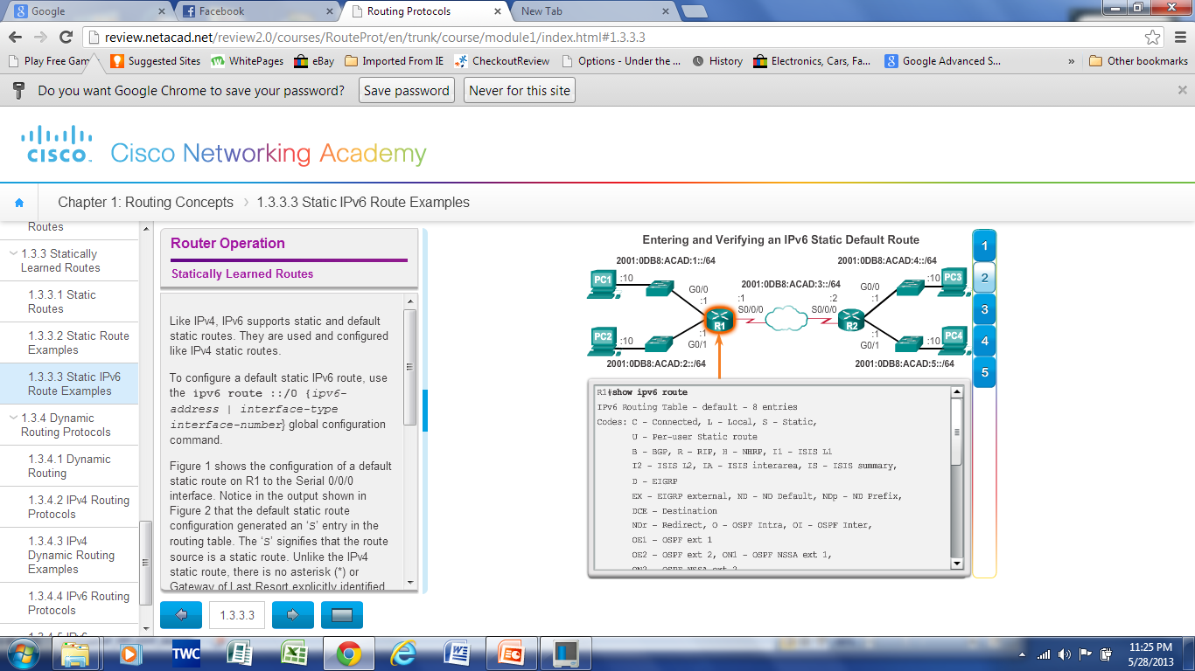
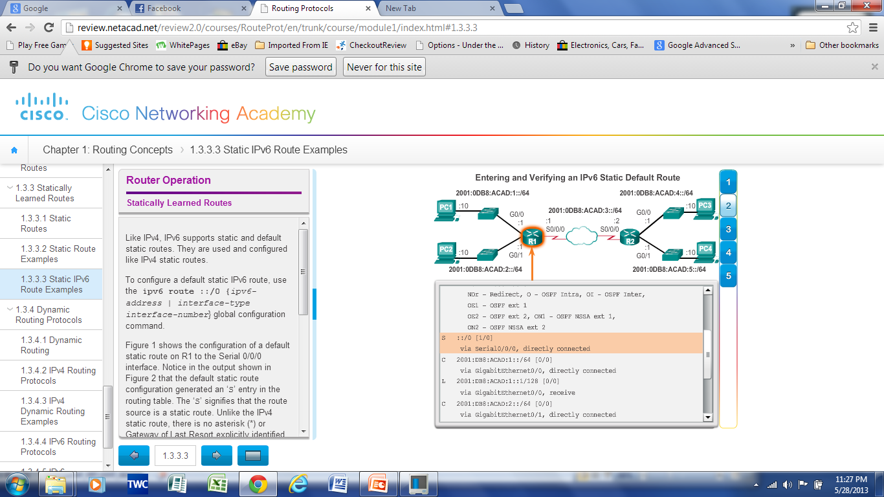
Statically Learned Routes Static IPv6 Routes Example
Notes:
4.3.3.3 Static IPv6 Route Example

Slide 48
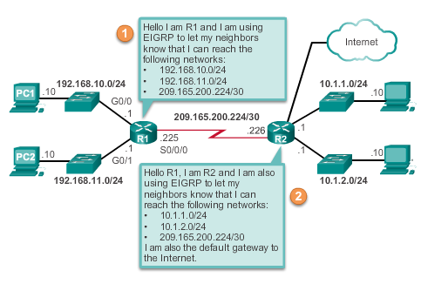
Dynamic Routing Protocols Dynamic Routing
Dynamic routing is used by routers to share information about the reachability and status of remote networks. It performs network discovery and maintains routing tables.
Notes:
4.3.4.1 Dynamic Routing

Slide 49
Dynamic Routing Protocols IPv4 Routing Protocols
Cisco ISR routers can support a variety of dynamic IPv4 routing protocols including:
EIGRP – Enhanced Interior Gateway Routing Protocol
OSPF – Open Shortest Path First
IS-IS – Intermediate System-to-Intermediate System
RIP – Routing Information Protocol
Notes:
4.3.4.2 IPv4 Routing Protocols

Slide 50
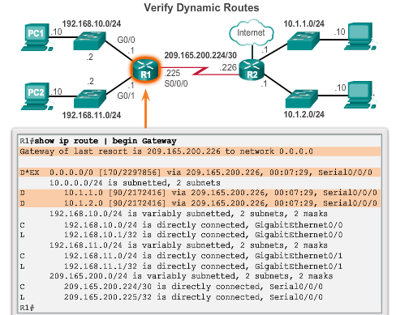
Dynamic Routing Protocols IPv4 Routing Protocols
Notes:
4.3.4.3 IPv4 Routing Protocols Example

Slide 51
Dynamic Routing Protocols IPv6 Routing Protocols
Cisco ISR routers can support a variety of dynamic IPv6 routing protocols including:
RIPng - RIP next generation
OSPFv3
EIGRP for IPv6
MP-BGP4 - Multicast Protocol-Border Gateway Protocol
Notes:
4.3.4.4 IPv6 Routing Protocols

Slide 52
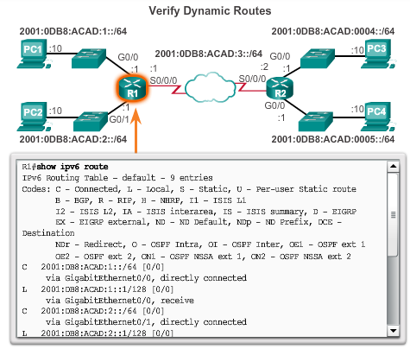
Dynamic Routing Protocols IPv6 Routing Protocols
Notes:
4.3.4.5 IPv6 Routing Protocols Example

Slide 53
Chapter 4: Summary
There are many key structures and performance-related characteristics referred to when discussing networks: topology, speed, cost, security, availability, scalability, and reliability.
Cisco routers and Cisco switches have many similarities. They support a similar modal operating system, similar command structures, and many of the same commands.
One distinguishing feature between switches and routers is the type of interfaces supported by each.
The main purpose of a router is to connect multiple networks and forward packets from one network to the next. This means that a router typically has multiple interfaces. Each interface is a member or host on a different IP network.
Notes:
Chapter 4 Summary

Slide 54
Chapter 4: Summary (cont.)
The routing table is a list of networks known by the router.
A remote network is a network that can only be reached by forwarding the packet to another router.
Remote networks are added to the routing table in two ways: either by the network administrator manually configuring static routes or by implementing a dynamic routing protocol.
Static routes do not have as much overhead as dynamic routing protocols; however, static routes can require more maintenance if the topology is constantly changing or is unstable.
Dynamic routing protocols automatically adjust to changes without any intervention from the network administrator. Dynamic routing protocols require more CPU processing and also use a certain amount of link capacity for routing updates and messages.
Notes:
Chapter 4 Summary

Slide 55
Chapter 4: Summary (cont.)
Routers make their primary forwarding decision at Layer 3, the Network layer. However, router interfaces participate in Layers 1, 2, and 3. Layer 3 IP packets are encapsulated into a Layer 2 data link frame and encoded into bits at Layer 1.
Router interfaces participate in Layer 2 processes associated with their encapsulation. For example, an Ethernet interface on a router participates in the ARP process like other hosts on that LAN.
Components of the IPv6 routing table are very similar to the IPv4 routing table. For instance, it is populated using directly connected interfaces, static routes and dynamically learned routes.
Notes:
Chapter 4 Summary

Slide 56


